Slide 1


ΠCODE MICRODISC TECHNOLOGY
CAN BE A FAST AND SENSITIVE ALTERNATIVE FOR LUNG ADENOCARCINOMA GENOTYPING
COMPARABLE TO NEXT GENERATION SEQUENCING
ID 130146
34º Congresso Brasileiro de Patologia
27º Congresso Brasileiro de Citopatologia
Ibere Cauduro Soares¹
ibere.soares@hc.fm.usp.br
Tarcia Augusto da Costa Barboza de Carvalho¹
Sandra Satie Koide²
Evandro Sobroza de Mello¹
1 Patologia Molecular, Laboratório de Patologia, Instituto do Câncer do Estado de São Paulo
ICESP, University of São Paulo School of Medicine (FMUSP), São Paulo SP, Brazil.
2 Oncoclinicas, São Paulo SP, Brazil.
Funding: Biomedica and PlexBio

Slide 2
Disclosure
Authors:
- No.
Investigation:
- Yes:
Funding: Biomédica Equipamentos e Suprimentos Hospitalares Ltda.
PlexBio

Slide 3
Introduction and Objectives
Treatment of lung adenocarcinoma (LA) has been revolutionary changed during past 20 years due to development of target therapy usually directed to specific nucleotide substitution (point mutations), short deletions / insertions or gene fusions.
NGS (next generation sequencing) is considered the standard of care to detect those actionable gene variants.
Techniques with shorter bench/analytic time can shorten the distance between getting a sample and obtaining a result, considering they keep comparable clinical sensitivity. ^{1,2,3,4}

Slide 4
Introduction and Objectives
πCode microdisc technology (πCMT) couples bright field microdisc detection with dark field fluorescent hybridization.
It allows multiplex analysis of either genotype or antigen targets.

Slide 5
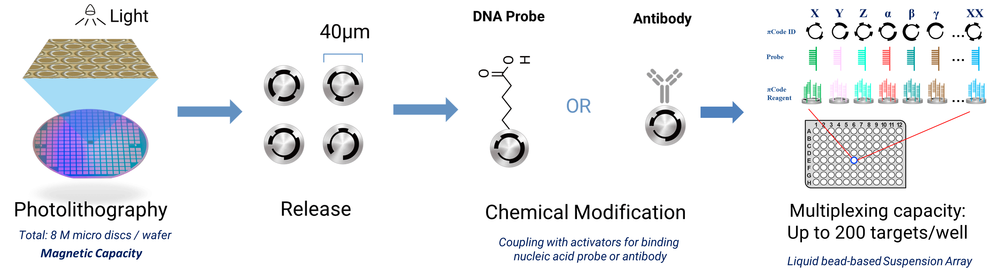
Introduction and Objectives

Slide 6
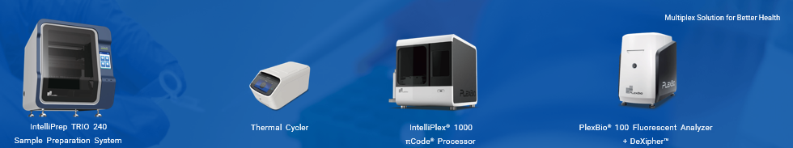
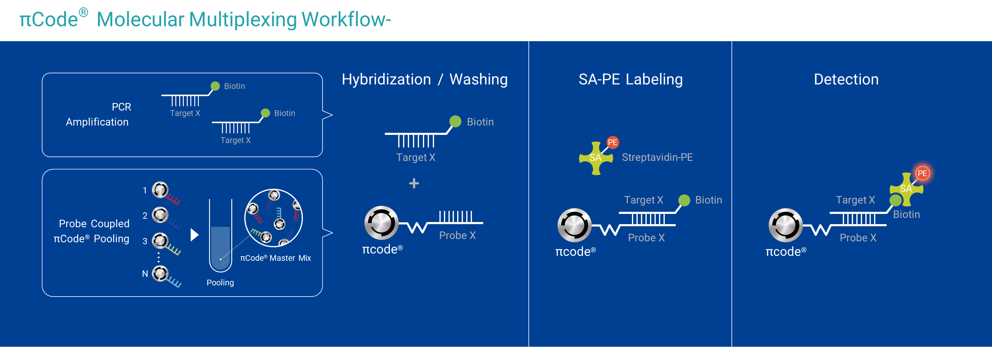
Introduction and Objectives

Slide 7
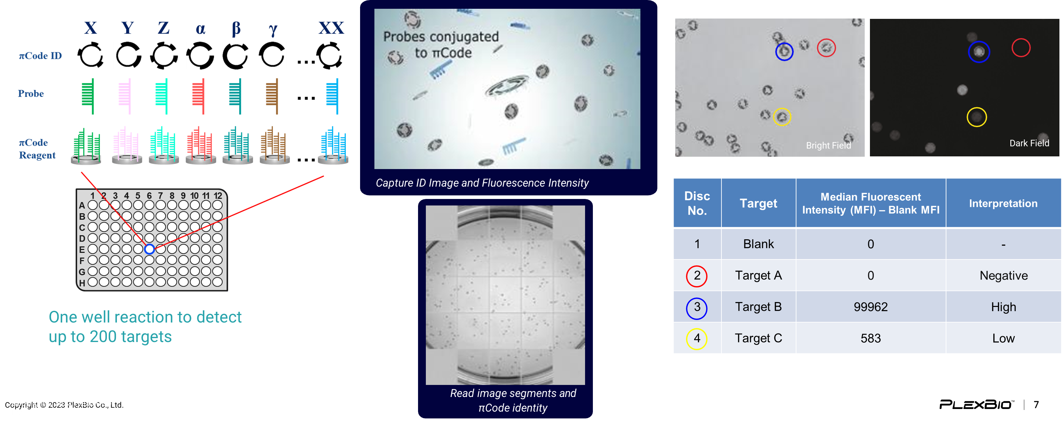
Introduction and Objectives

Slide 8
Introduction and Objectives
OVERNIGHT
SEQUENCING
D/RNA EXTRACTION
LIBRARY PREP
LIBRARY PREP
SOFWARE RUN
ANALYSIS
CAPTURE
NGS
D/RNA EXTRACTION
PREP
DETECTION
ANALYSIS
πCODE
MICRODISC
TECHNOLOGY

Slide 9
Introduction and Objectives
Our main objective was to compare
clinical sensitivity (accuracy) of
πCode Microdisc Technology
to Next Generation Sequencing
for lung adenocarcinoma actionable gene variants detection.

Slide 10
Methods
After DNA extraction from LA formalin fixed paraffin embedded samples, twelve actionable variant EGFR, KRAS, NRAS, ERBB2 positive cases by NGS capture assay (a SureSelect XTHS2 Agilent 40 genes customized panel) collected in a two-month period (December 2023-January 2024) were subsequently tested with a genotyping πCode Microdisc Technology assay (IntelliPlex lung cancer panel – DNA, PlexBio). The bench time needed for this πCMT assay was around 6 hours.

Slide 11
Methods

Slide 12
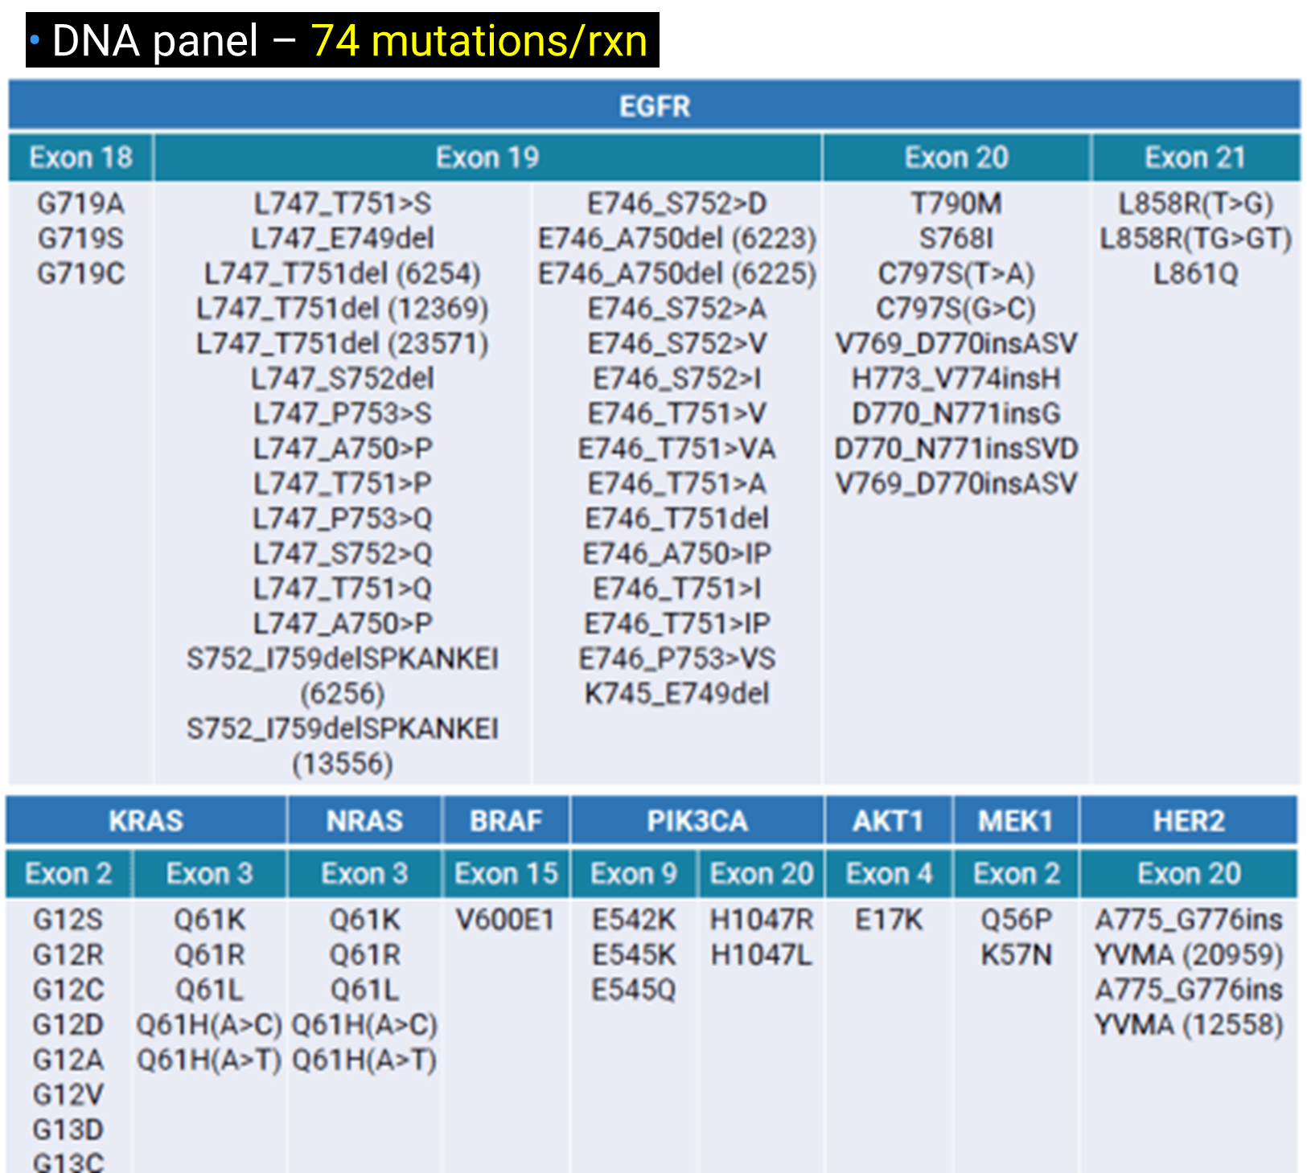
IntelliPlex lung cancer panel – DNA
Methods

Slide 13
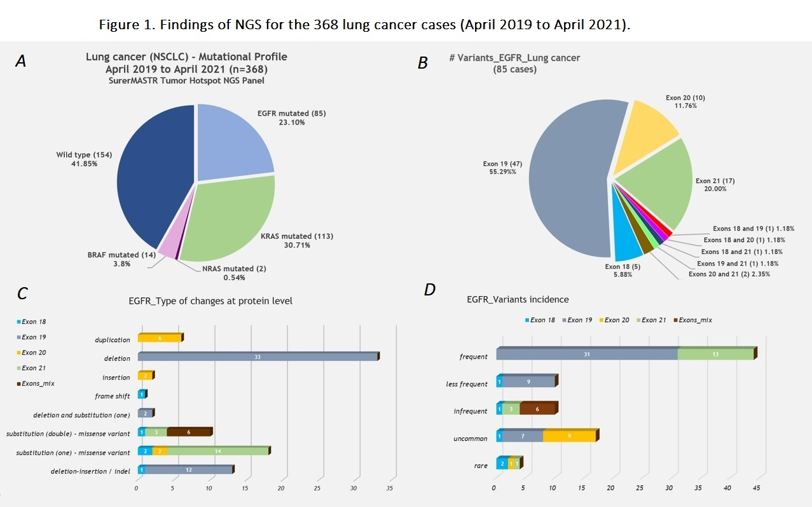
Methods
IntelliPlex lung cancer panel – DNA
References: ^{4,5}

Slide 14
NGS
Actionable Variants
Results and Discussion
Gene | n | Variants
EGFR | 7 | (3) L858R (3 ≠) exon 19 deletions L858R and V689L
KRAS | 3 | (3) G12C
BRAF | 1 | V600E
ERBB2 (HER2) | 1 | E770_A771ins

Slide 15
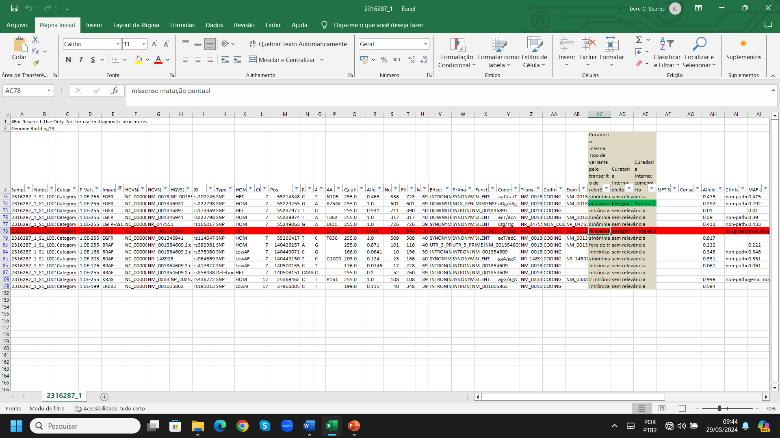
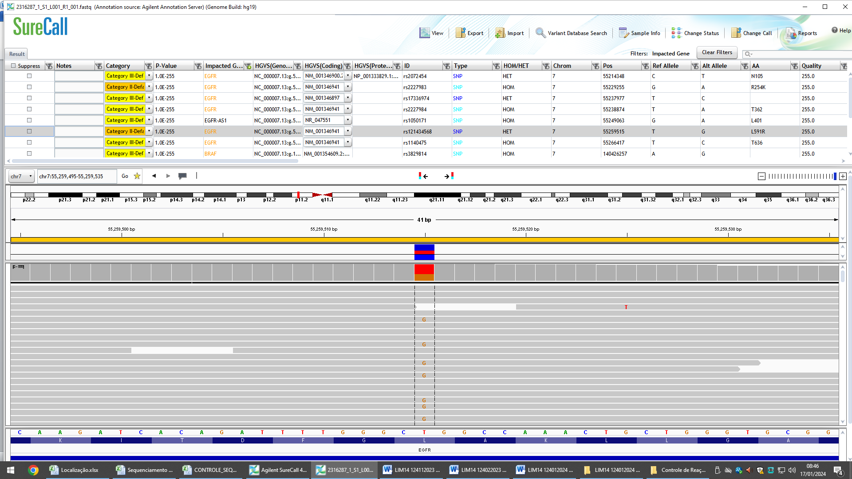
Results and Discussion
L858R

Slide 16
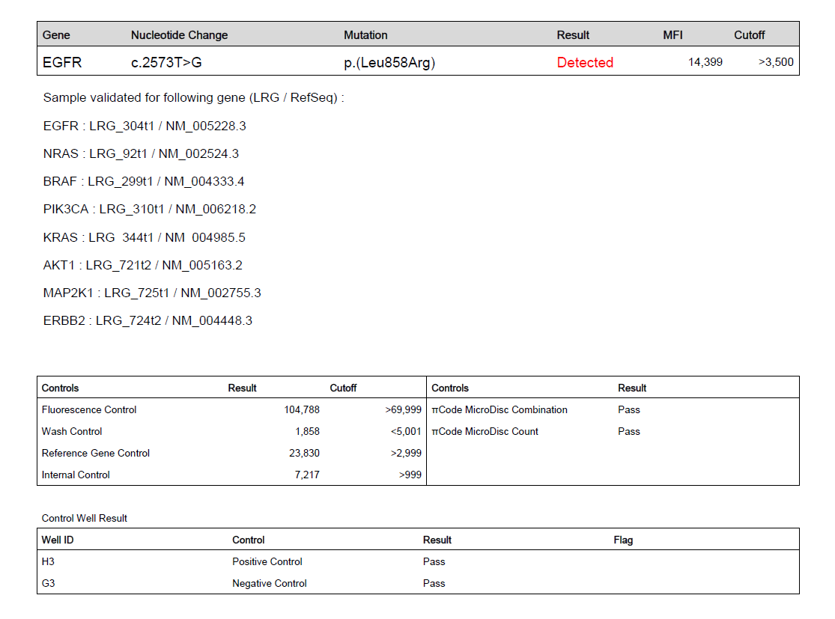
Results and Discussion
EGFR L858R

Slide 17
Results and Discussion
EGFR L858R

Slide 18
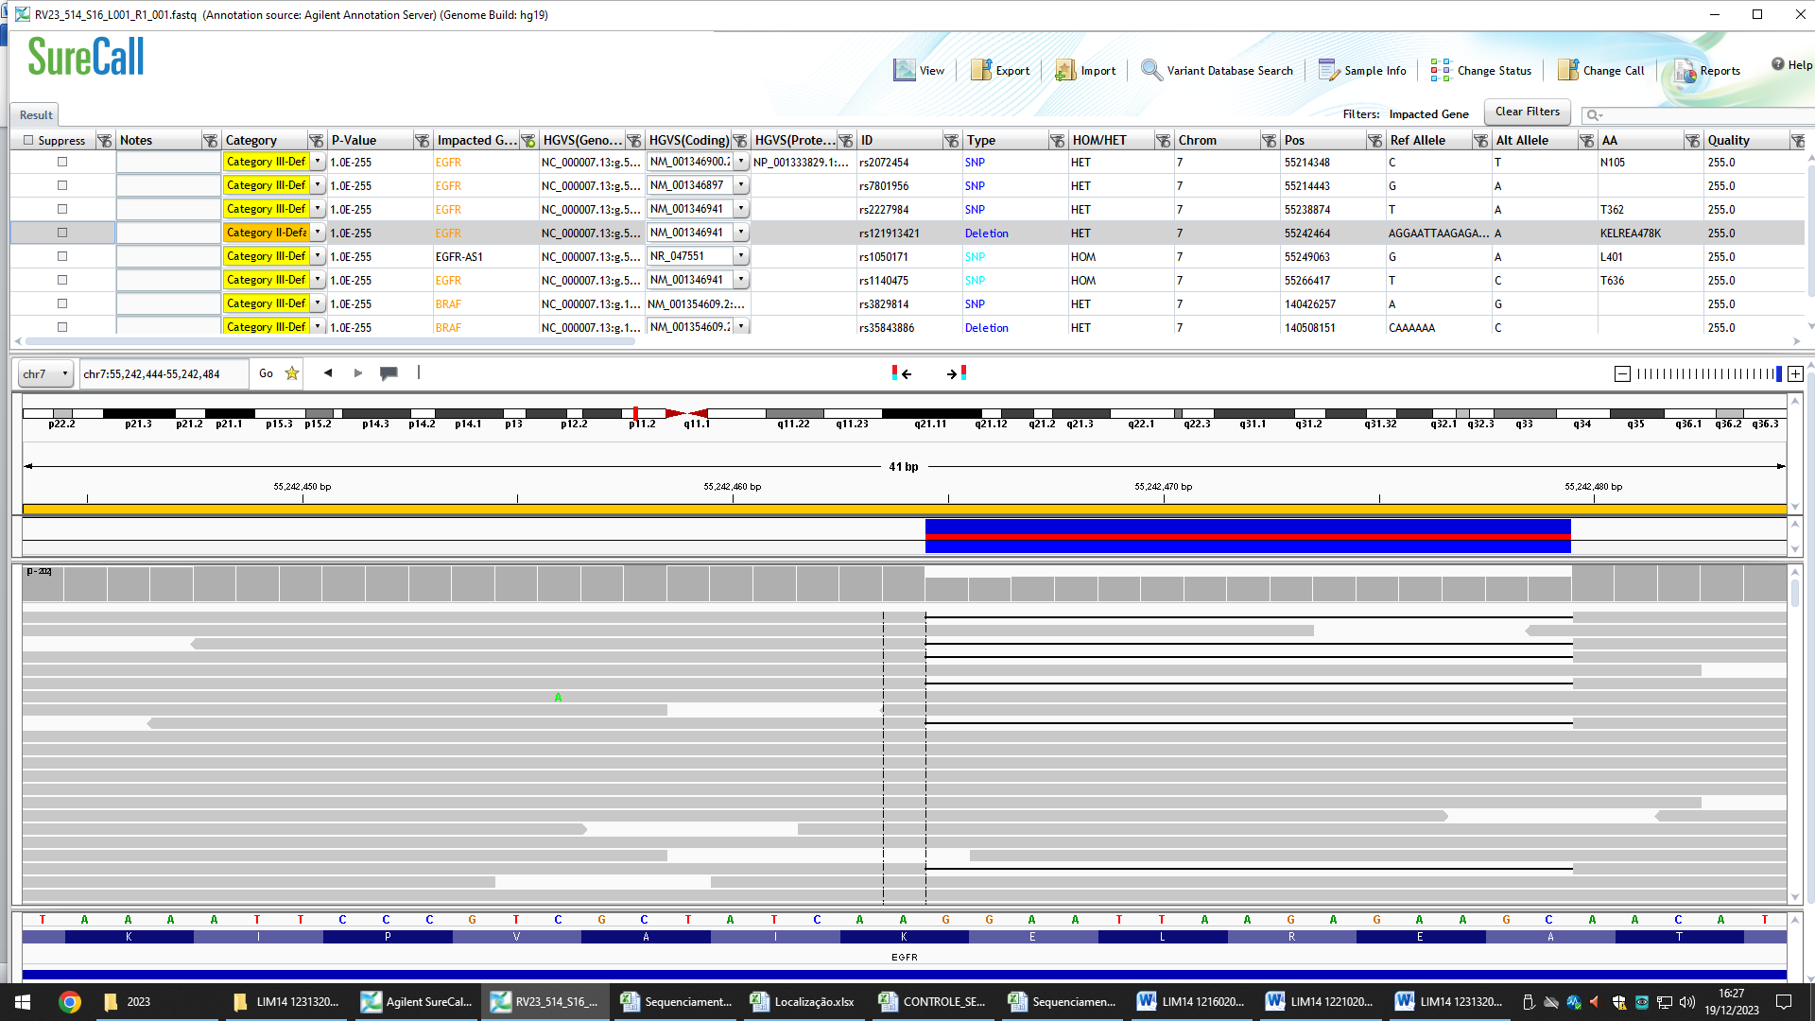
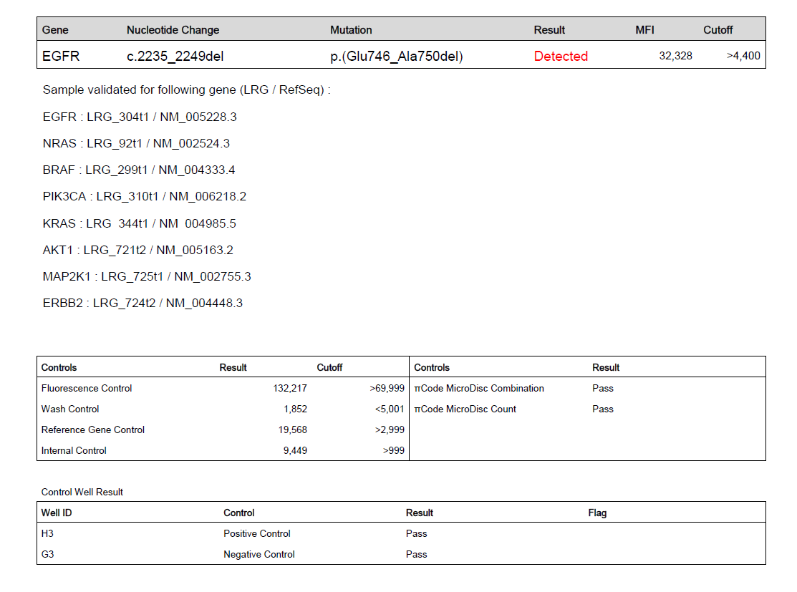
Results and Discussion
EGFR Exon 19 Deletion p.E746_A750del

Slide 19
Results and Discussion

Slide 20
Results and Discussion

Slide 21
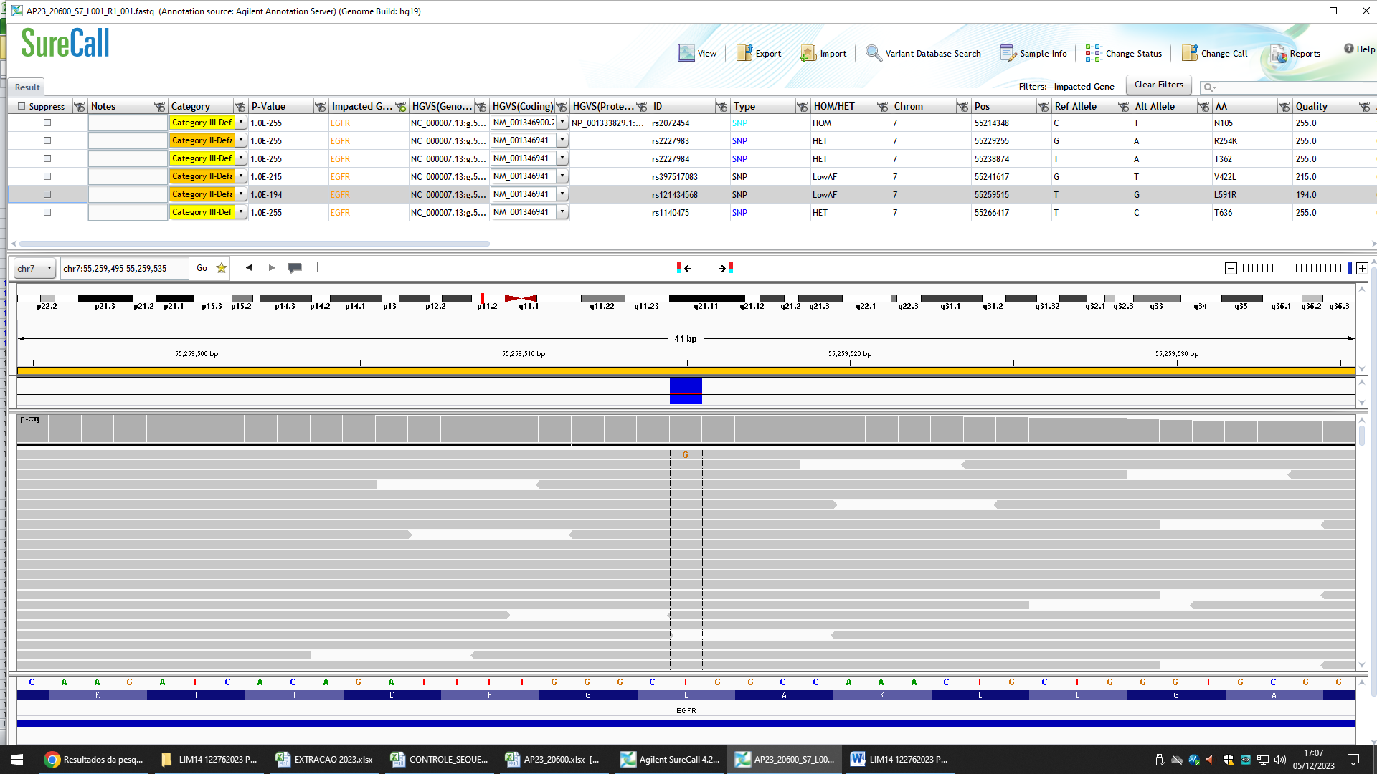
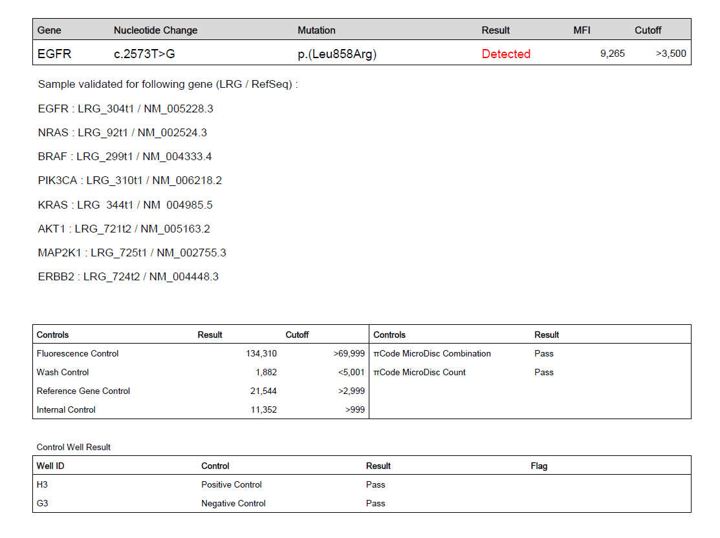
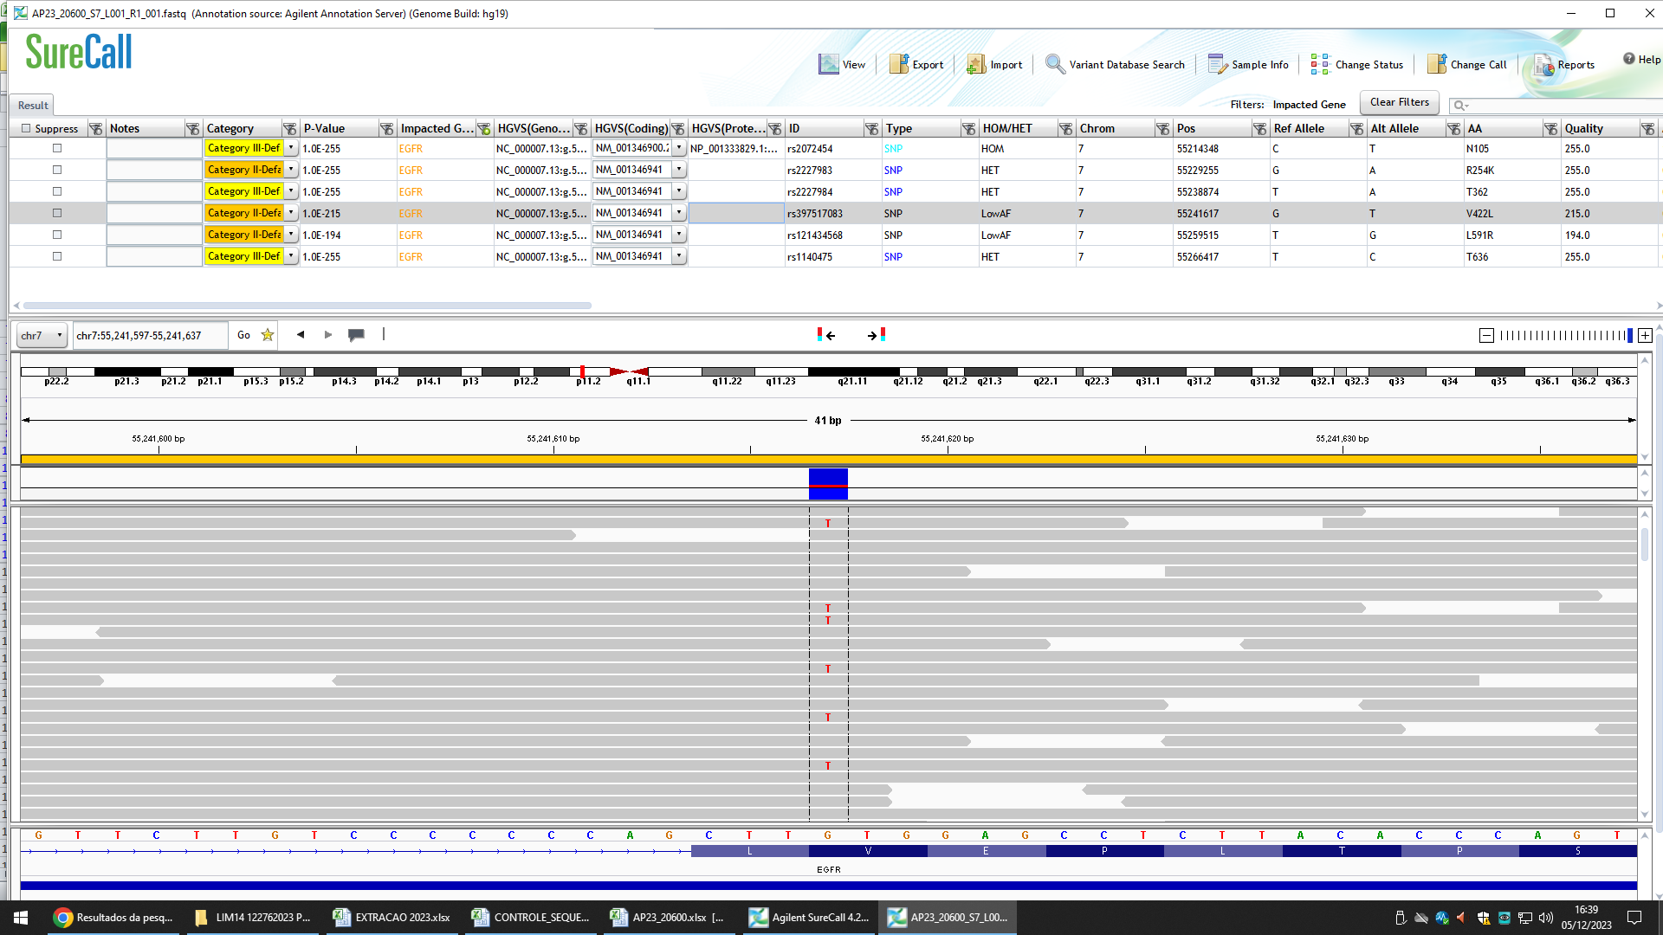
Results and Discussion
EGFR L858R and V689L

Slide 23
Results and Discussion
EGFR L858R and V689L

Slide 24
Results and Discussion
n = 12
Clinical Sensitivity (actionable variant)
IntelliPlex lung cancer panel – DNA (πCMT)
Vs SureSelect XTHS2 40 genes customized panel (NGS)
12/12 = 1,0 = 100%
L858R known actionable variant
V689L variant of undetermined significance

Slide 25
Clinical Sensitivity (actionable variant)
IntelliPlex lung cancer panel – DNA (πCMT)
Vs SureSelect XTHS2 40 genes customized panel (NGS)
12/12 = 1,0 = 100%
Results and Discussion
Paper | πCMT assay | Clinical Sensitivity | Specificity
7. Kao JH et al. Diagn Microbiol Infect Dis. 2019; 94(4):344-348. | IntelliPlex HCV Genotyping Assay | 96.9% | 100%
8. Chen CL et al. Mol Diagn Ther. 2019; 23(5):645-656. | IntelliPlex™ KRAS G12/13 Mutation Assay | 100% | 90.8%
9. Wu CH et al. Pathol Res Pract. 2024; 257:155304. PMID: 38657557. | IntelliPlex-LCP-DNA Assay | 25% Caveats: n=4 Only double couplets variants | ---

Slide 26
References
1. Pennell NA, Arcila ME, Gandara DR, West H. Biomarker Testing for Patients With Advanced Non-Small Cell Lung Cancer: Real-World Issues and Tough Choices. Am Soc Clin Oncol Educ Book. 2019 Jan;39:531-542. PMID: 31099633.
2. Planchard D, Popat S, Kerr K, Novello S, Smit EF, Faivre-Finn C, Mok TS, Reck M, Van Schil PE, Hellmann MD, Peters S; ESMO Guidelines Committee. Metastatic non-small cell lung cancer: ESMO Clinical Practice Guidelines for diagnosis, treatment and follow-up. Ann Oncol. 2018 Oct 1;29(Suppl 4):iv192-iv237. PMID: 30285222.
3. Ettinger DS, Wood DE, Aisner DL, Akerley W, Bauman JR, Bharat A, Bruno DS, Chang JY, Chirieac LR, D'Amico TA, Dilling TJ, Dowell J, Gettinger S, Gubens MA, Hegde A, Hennon M, Lackner RP, Lanuti M, Leal TA, Lin J, Loo BW Jr, Lovly CM, Martins RG, Massarelli E, Morgensztern D, Ng T, Otterson GA, Patel SP, Riely GJ, Schild SE, Shapiro TA, Singh AP, Stevenson J, Tam A, Yanagawa J, Yang SC, Gregory KM, Hughes M. NCCN Guidelines Insights: Non-Small Cell Lung Cancer, Version 2.2021. J Natl Compr Canc Netw. 2021 Mar 2;19(3):254-266. PMID: 33668021.
4. Lindeman NI, Cagle PT, Aisner DL, Arcila ME, Beasley MB, Bernicker EH, Colasacco C, Dacic S, Hirsch FR, Kerr K, Kwiatkowski DJ, Ladanyi M, Nowak JA, Sholl L, Temple-Smolkin R, Solomon B, Souter LH, Thunnissen E, Tsao MS, Ventura CB, Wynes MW, Yatabe Y. Updated Molecular Testing Guideline for the Selection of Lung Cancer Patients for Treatment With Targeted Tyrosine Kinase Inhibitors: Guideline From the College of American Pathologists, the International Association for the Study of Lung Cancer, and the Association for Molecular Pathology. Arch Pathol Lab Med. 2018 Mar;142(3):321-346. PMID: 29355391.
5. Sharma SV, Bell DW, Settleman J, Haber DA. Epidermal growth factor receptor mutations in lung cancer. Nat Rev Cancer 2007; 7, 169.
6. Pasqualoto KFM, Soares IC, de Castro Junior G, Alves VAF, de Mello ES. Exploring in silico tools and 3D molecular properties to predict pathogenicity and structural protein interactions of rare EGFR variants detected in a large cohort of patients with lung adenocarcinoma. 34º Congresso Brasileiro de Patologia, Belém – PA, Brazil, 2024.
7. Kao JH, Lin CY, Chuang WL, Cheng YY, Hu JY, Liang WK, Friebe P, Palmer S, Huang CS. Clinical evaluation of IntelliPlexTM HCV genotyping kit for hepatitis C virus genotyping. Diagn Microbiol Infect Dis. 2019 Aug;94(4):344-348. PMID: 30975461.
8. Chen CL, Chen CK, Ho CL, Chi WM, Yeh CH, Hu SP, Friebe P, Palmer S, Huang CS. Clinical Evaluation of IntelliPlex™ KRAS G12/13 Mutation Kit for Detection of KRAS Mutations in Codon 12 and 13: A Novel Multiplex Approach. Mol Diagn Ther. 2019 Oct;23(5):645-656. PMID: 31347028.
9. Wu CH, Zhang MS, Huang YL, Cheng WH, Lai JY, Hsieh MS, Liao WY. Lung adenocarcinoma with EGFR L858R-K860I and L858R-L861F doublet mutations from which the L858R mutation is undetectable through the cobas EGFR mutation test v2. Pathol Res Pract. 2024 May;257:155304. PMID: 38657557.

Slide 27
What Next?
Increase n
(for clinical sensitivity assay)
Add
Clinical specificity assay
Precision assay
Analytical sensitivity assay
Add
Cost-Effect analysis
Add
Other πCMT assays

Slide 28
Conclusion
πCode microdisc technology can be a successful and sensitive alternative to NGS for lung adenocarcinoma genotyping with a high concordance rate between the two technologies.
Short bench time of πCMT (around 6 hours) gives an extra advantage to this technology, considering the urge for a rapid treatment beginning.

Slide 29
OBRIGADO!!

